Slide 1

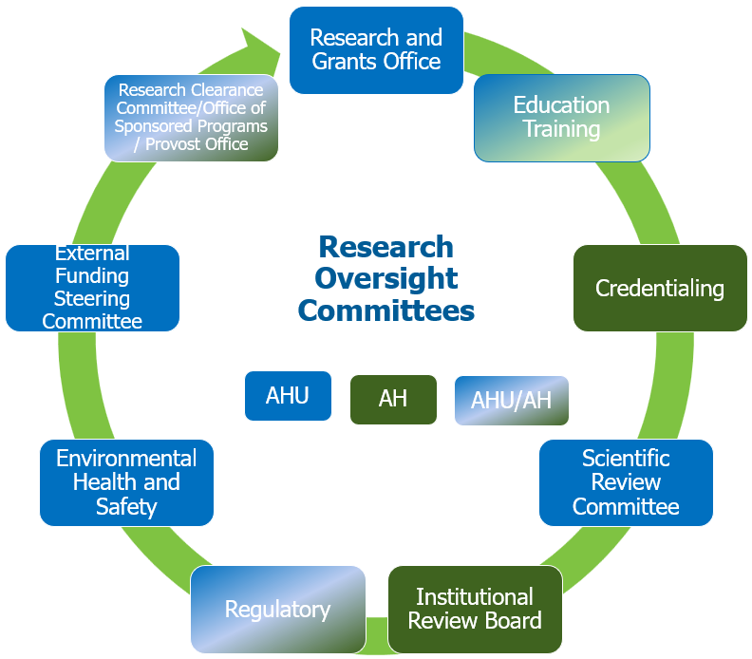

Scholarly Project Submission and Review Process Workflow
Principal Investigator’s Responsibility
Research and Grants Office’s Responsibility
TYPE OF SCHOLARLY PROJECT (See slide notes for definitions)
HUMAN SUBJECT RESEARCH
START
SUBMIT ONLINE AT
https://my.ahu.edu/academics/research-and-grants
NEED GUIDANCE?
RGO@ahu.edu
NOT-HUMAN SUBJECT RESEARCH
QUALITY IMPROVIEMENT QUALITY ASSESSMENT
(QI/QA)
FEASIBILITY
EVIDENCE-BASED PRACTICE (EBP) with data collection
OTHER
CASE-STUDY
CASE-REPORT
LITERATURE REVIEW,
EDUCATIONAL MODULE, OTHER with NO data collection
Do NOT need to submit for review
Notes:
Research:
Definition: Under the federal Common Rule, “research”, "means a systematic investigation, including research development, testing, and evaluation, designed to develop or contribute to generalizable knowledge. In addition, the FDA has separate definitions for what constitutes research and therefore, if your project includes use of a drug, device or biologic, it may be subject to FDA regulations and require IRB review. While some activities are typically outside the realm of research (e.g., operational activities such as defined practice activities in public health and medicine, or internal management activities such as quality improvement, quality assessment and program evaluation), some of these activities may constitute research in circumstances where there is a clear intent to contribute to generalizable knowledge.
Human Subject Research (HSR):
Definition: According to 45 CFR 46, a human subject is "a living individual about whom an investigator (whether professional or student) conducting research:
- Obtains information or biospecimens through intervention or interaction with the individual, and uses, studies, or analyzes the information or biospecimens; or
Obtains, uses, studies, analyzes, or generates identifiable private information or identifiable biospecimens.“
Intervention includes both physical procedures by which information or biospecimens are gathered (e.g., venipuncture) and manipulations of the subject or the subject's environment that are performed for research purposes.
Interaction includes communication or interpersonal contact between investigator and subject.
Private information includes information about behavior that occurs in a context in which an individual can reasonably expect that no observation or recording is taking place, and information that has been provided for specific purposes by an individual and that the individual can reasonably expect will not be made public (e.g., a medical record).
Identifiable private information is private information for which the identity of the subject is or may readily be ascertained by the investigator or associated with the information.
An identifiable biospecimen is a biospecimen for which the identity of the subject is or may readily be ascertained by the investigator or associated with the biospecimen."
IRB oversight: Human Subject Research (HSR) is governed by federal regulation, under IRB oversight.
Examples of this type of research include drug trials, internet surveys, research involving risky behaviors or attitudes, open-ended interviews with minors that contribute to generalizable knowledge.
Non-Human Subject Research:
Definition: Any study that does not involve a human subject, or a clinical investigation as defined according to 45 CFR 46 as Human Subject Research.
IRB oversight: Studies that do not involve human subjects do not require IRB oversight. However, the IRB may provide a formal determination that the project does not involve human subjects.
Examples of this type of research include study in which there is no interaction or intervention with living individuals, and neither the provider of the specimens/data nor the recipient can link the specimens/data with identifiable individuals (living or dead); animal experiment; cell culture study.
QI/QA and Feasibility study:
Definition: There is no regulatory definition but often QA/QI is described as “systematic, data-guided activities designed to bring about immediate (or nearly immediate) improvements in health care delivery, educational settings, and other systems to make changes that will potentially lead to better patient outcomes, better system performance, and better professional development.
IRB oversight: QI/QA is NOT subject to review as research, as defined under federal regulation and IRB oversight. However, the IRB may provide a formal determination that the project is not research.
Examples of this type of research include ensuring new evidence-based interventions are incorporated into practice, improvement of an educational curriculum, reduction in in-patient admissions and length of stay.
Case-Study/Case Series and Case Report:
Definition: A case study has been described as an intensive, systematic investigation of a single individual, group, community or some other unit in which the researcher examines in-depth data relating to several variables. If information on more than three individuals is included, the case series is considered to be research, and therefore submission is required to the IRB.
IRB oversight: IRB does not oversee case-studies.
Examples of a type of clinical case report or case study is a description of an individual patient rare diagnosis, history, and medical treatment.
Evidence-Based Practice (EBP):
Evidence-Based Practice (EBP), including literature review (traditional, systematic, or meta-analysis), educational module development, or other types of studies that do not have data collection, are NOT required to submit to the Research Office (SRC, IRB, EHS).
*IRB Review
Human Subjects Research requires IRB review and approval. There are three major types of review: Exempt, Expedited, and Full.
**IRB Determination
IRB makes “determination” of Non-Human Subject Research and Non-Research (QI/QA). There is no IRB oversight of these studies.
***Institutional Clearance
AdventHealth does not provide institutional clearance (IC) for AHU projects because the two institutions are separate. IC is a continued process that starts from the time of submission.

Slide 2
Requirements
BEFORE
Submission: HUMAN SUBJECT RESEARCH (HSR)
Submit to the AHU Research Website at https://my.ahu.edu/academics/research/online-submissions/new-proposal-application
(do NOT email or upload documents at the IRBNet)
Documents Human Subject Research:
Appropriate AH Proposal template:
  HRP-504 - Prospective Research Study Protocol
  HRP-504 - Qualitative Research Study Protocol
  HRP-504 - Retrospective Research Study Protocol
AHU Delegation Authority Log (DOA)
Study Site(s) approval letter(s), if applicable
Department Chair/Director Letter of Support
HRP-200 FORM: Initial Review Application
Appropriate AH Consent Form
  HRP-500 – Template Consent
  HRP-501 - Template Consent for Minimal Risk Research
  HRP-508 – Template Consent for Exempt Research
Principal Investigator Curriculum Vitae (CV)
Principal Investigator Professional State License, if applicable
Questionnaire(s)/Survey(s), if applicable
Requirement Human Subject Research:
IRBnet account (all investigators, including students)
CITI training under AdventHealth Orlando affiliation (all investigators, including students)
  Basic Biomedical or Basic Social/Behavioral
  Health Information Privacy and Security (HIPS)
  Good Clinical Practice (GCP), if the study is subject to FDA
Link IRBNet account and AdventHealth Orlando CITI account (all investigators)
TYPE OF STUDY:
HUMAN SUBJECT RESEARCH

Slide 3
Requirements
BEFORE
Submission: NON-HUMAN SUBJECT RESEARCH (NHSR)
Submit to the AHU Research Website at https://my.ahu.edu/academics/research/online-submissions/new-proposal-application
(do NOT email or upload documents at the IRBNet)
Requirements Non-Human Subject Research:
IRBnet account (only PI)
CITI certificates under AdventHealth University affiliation (All investigators, including students)
  All types of NHSR: Responsible Conduct of Research (RCR)
  If Biological, chemical, or radiation research: contact the Research and Grants Office for instructions on Biosafety/Biosecurity training
  If Animal study: contact the Research Office for instruction on Animal Care and Use (ACU) and Laboratory Animal Research training
Documents Non-Human Subject Research:
AHU Non-Human Subject Research Proposal/Protocol
AHU Delegation Authority Log (DOA)
Study Site(s) approval letter(s), if applicable
Department Chair/Director Letter of Support
Determination of Non-Human Subject Research vs. NRSH
IACUC approval from the partnering institution, if an animal study
Principal Investigator Curriculum Vitae (CV)
TYPE OF STUDY:
NON-HUMAN SUBJECT RESEARCH

Slide 4
Requirements
BEFORE
Submission: QUALITY IMPROVEMENT / QUALITY ASSESSMEMT
Submit to the AHU Research Website at https://my.ahu.edu/academics/research/online-submissions/new-proposal-application
(do NOT email or upload documents at the IRBNet)
TYPE OF STUDY:
QUALITY IMPROVEMENT QUALITY ASSESSMENT
(QI/QA)
FEASIBILITY
EVIDENCE-BASED PRACTICE (EBP) with data collection
OTHER (Specify)
Documents for SRC, EHS, and Institutional Clearance Review and IRB Determination of QI/QA:
AHU QI/QA Proposal
AHU Delegation Authority Log (DOA)
Study Site(s) approval letter(s)
Department Chair/Director Letter of Support
Determination of QI/QA vs. Research
Participant Agreement, if human participants
Principal Investigator Curriculum Vitae (CV)
Principal Investigator Professional State License, if applicable
Questionnaire(s)/Survey(s), if applicable
Requirements Quality Improvement/Quality Assessment:
IRBNet account (only PI)

Slide 5
Requirements
BEFORE
Submission: CASE-STUDY / CASE SERIES
Submit to the AHU Research Website at https://my.ahu.edu/academics/research/online-submissions/new-proposal-application
(do NOT email or upload documents at the IRBNet)
Documents for SRC, EHS, and Institutional Clearance Review of Case Study/Case Series:
AHU Case-Study/Case Series Proposal Template
AHU Delegation Authority Log (DOA)
Study Site(s) approval letter(s)
Department Chair/Director Letter of Support Template
Participant Agreement Template, if human participants
Principal Investigator Curriculum Vitae (CV)
Principal Investigator Professional State License, if applicable
Questionnaire(s)/Survey(s), if applicable
TYPE OF STUDY:
CASE-STUDY/CASE-SERIES
Requirements Quality Improvement/Quality Assessment:
None

Slide 6
Scholarly Activity Review Process Workflow – Requirements AFTER Approvals
Submit to the AHU Research Website at https://my.ahu.edu/academics/research/online-submissions
(do NOT email or upload documents at the IRBNet)
When necessary:
1- Modifications/changes:
- online Study Change Request Form
- if changes to study personnel, upload AHU Delegation Authorization Log
Annually:
2- Status Report:
- online Study Status Report / Progress Report or Final Report
- upload HRP-202 FORM: Continuing Review Application
3- Prompt Report:
- online Study Status Report / Promptly Report
- upload HRP-204 Promptly Reportable Form
TYPE OF STUDY:
HUMAN SUBJECT RESEARCH
TYPE OF STUDY:
NON-HUMAN SUBJECT RESEARCH
When necessary:
1- Modifications/changes:
- online Study Change Request Form
- if changes to study personnel, upload AHU Delegation Authorization Log
Annually:
2- Status Report:
- online Study Status Report / Progress Report or Final Report
3- Prompt Report:
- online Study Status Report / Promptly Report
- upload HRP-204 Promptly Reportable Form
TYPE OF STUDY:
QUALITY IMPROVIEMENT QUALITY ASSESSMENT
(QI/QA)
FEASIABILITY
OTHER (Specify)
TYPE OF STUDY:
CASE-STUDY/CASE-REPORT

